Slide 1


Slide 2

SNIFFING / EAVERDROPPING

Slide 3
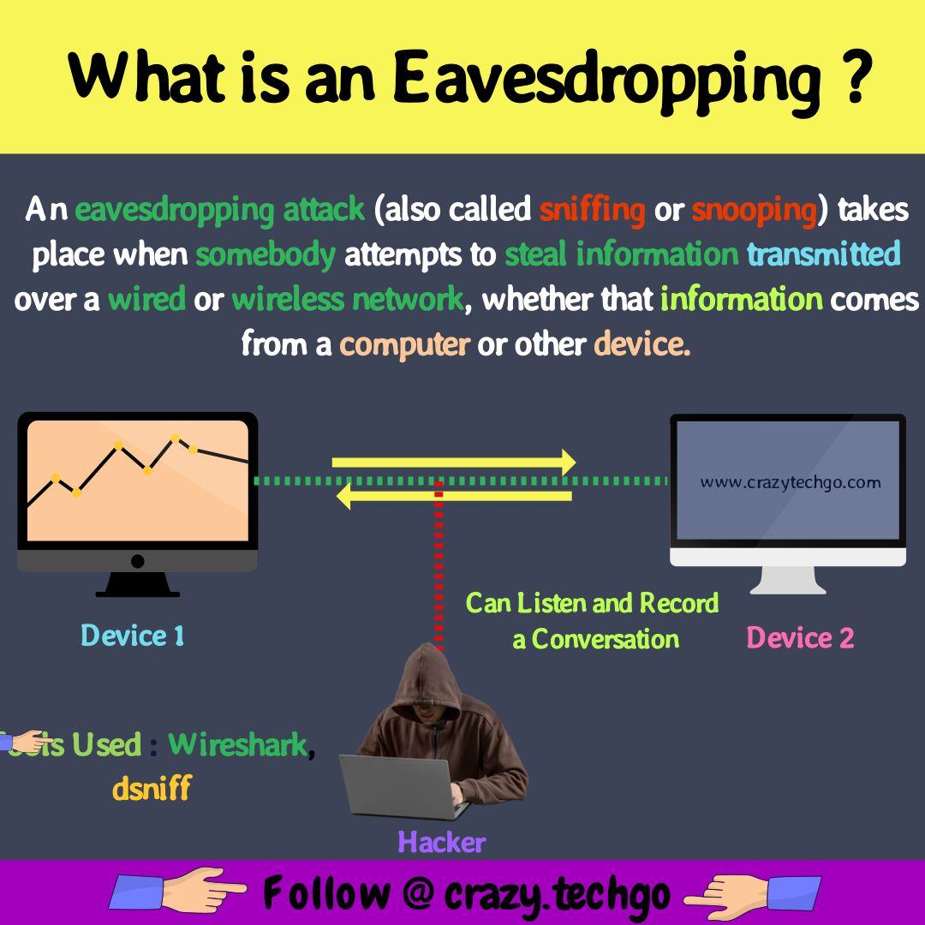
Through these attacks, your information like passwords, card details, and other sensitive data is easily stolen while it is getting transferred from one device to another.

Slide 4
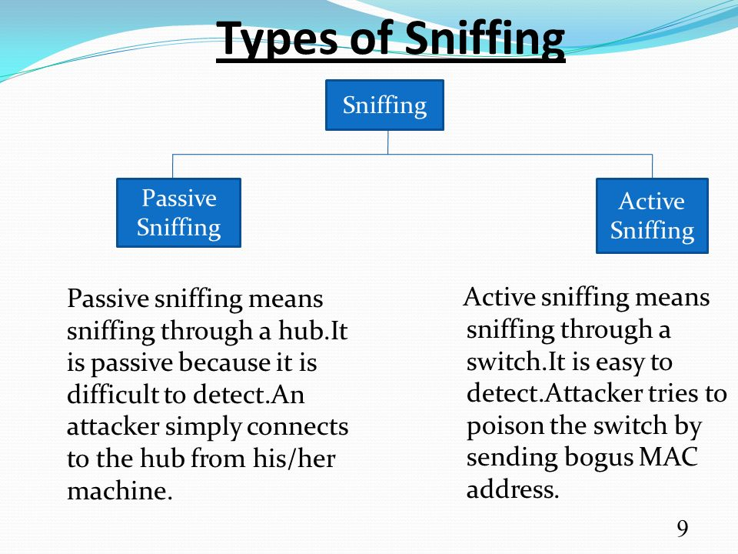

Slide 5
PROTOCOLS VULNERABLE TO SNIFFING
Protocols that are susceptible to sniffers include:
Telnet & Rlogin : Keystrokes including usernames and passwords.
HTTP : Data sent in clear Text
SMTP ,NNTP ,POP ,FTP ,IMAP
Creds or sensitive information sent in clear text can be easily seen

Slide 6
SNIFFING TOOLS
Wireshark : Is a freeware sniffer that can capture packets from a wired or wireless LAN connections.
Snort : An IDS that also has sniffer capabilities. Can be used to detect variety of attacks and probes, such as BoF, Stealth port scans, CGI attacks, SMB and OS fingerprinting attempts.
WinDump : A windows version of tcpdump, can be used to watch, diagnose, and save to disk network traffic according to various rules.
Ettercap, Mitmproxy, netsniff-ng are some freely available tools on kali linux by default.

Slide 7
DEFEND AGAINST SNIFFING
Restrict the physical access to the network media to ensure that a packet sniffer cannot be installed
Use encryption to protect confidential information
Permanently add the MAC address of the gateway to the ARP cache
Use IPV6 instead of IPv4
Use encrypted sessions such as SSH instead of Telnet, Secure Copy(SCP) instead of FTP, SSL for email connection etc., to protect wireless network users against sniffing attacks.

Slide 8
CONCLUSION
Packet sniffers can capture clear text credentials or other valuables on transit. Packet sniffers are a serious matter for network security.
Since sniffing is possible on both switch and non-switched networks, it’s a good practice to encrypt data communications in a an organizations.

Slide 9
Thank You

